Slide 1
Cloud Architecture

Slide 2
Good Cloud Architecture Principles
Failures should not be considered interesting
Assume everything fails
Use loosely coupled components with defined service contracts
Increase resources proportional to the requirements
Automate for operational efficiency
Design for resiliency
Learn about efficient usage of each service
Optimize costs through good architecture

Slide 3
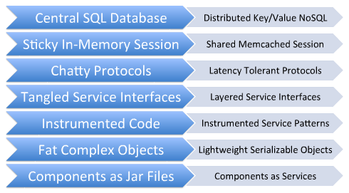
Old -> New

Slide 4
Cloud Migration/Adoption Process
Deployment Planning & Assessment
Cloud Architecture
Cloud Asset Setup
Cluster & Performance Analysis
Production Monitoring & Automation
Review current and future business requirements and develop relevant plans for cloud adoption including choice of cloud vendor and platform
Arrive at the right topology that suits customer needs, plan storage, security, production automation, user monitoring tools for analysis of resource usage
Create the components and configurations for your cloud assets including images, scripts, automation, monitoring and management tools. Configure HA & auto-scaling
Performance engineering, clustering, load balancing, sharding, caching, managing networks and storage performance
Standard and custom built reports, metrics and parameters on resource utilization and demand patterns plus load balancer for your services on the cloud

Slide 5
Scalability Perspectives
What needs to scale?
Compute
Memory
Network
Storage
Monitoring
Vertical scalability
Horizontal scalability
Scale across geographies
HPC workloads
Data Processing workloads
IO Latency
Provisioning time
Backup / Restore times
Failover
Ops

Slide 6
Disk & Storage layout
Try out various disk layouts before deciding your storage layout for your loads
RAID levels, LVM
DRBD, GlusterFS, Lustre, NFS
For your software components, does that storage backend allow easy backups?
MongoDB allows locking the DB for snapshots
But what if ext2 does not allow sync+lock?
XFS allows freeze/thaw

Slide 7
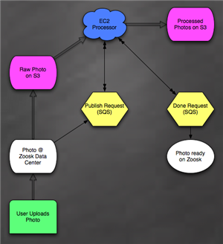
Loose Coupling - 1
Service Oriented Architecture
Messaging / Queue layer

Slide 8
Loose Coupling - 2
Amazon SQS: Reliable, scalable, hosted queue; exposed as web service
RabbitMQ: Open-source HA messaging system, clustering support
BeanStalkD: Simple, fast work queue
Clustering Application Servers
JBoss App Server, IBM WebSphere Application Server
Add or remove nodes on the fly – automate through scripting
Stateless behavior can be added when necessary
VPC now works across availability zones (AZ) – in the pipeline though

Slide 9
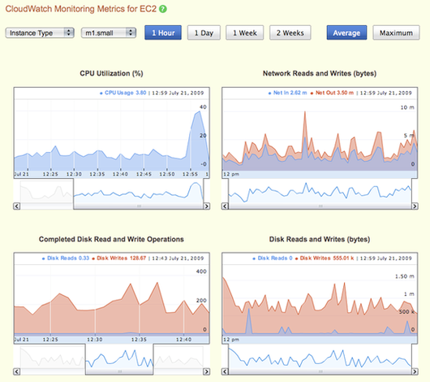
Monitoring & Logging
Amazon CloudWatch
Monitoring for AWS cloud resources & applications
Collect and track metrics – CPU, latency, request counts, custom metrics
Monitoring with your own tools
Using Hyperic or Nagios for monitoring specific layers of your stack or to leverage existing investments
Logging
No dependency on instances – copy necessary logs to S3 periodically

Slide 10
Best Practices for AWS Services
Compress a set of files before storing on S3
Use multi-threaded fetching
Exponential back-off & retries
Build security in each layer
Launch multiple instances together
Automate everything
Create network diagrams
Safeguard your security credentials
Monitor heavily and focus on data
Chaos monkey testing
Use “Termination Lock” for EC2 instances

Slide 11
Best Practices for AWS Services
Use Elastic IPs for consistent & remappable routes
Use multiple Availability zones
Create database slaves across Azs
Take periodic snapshots of your critical EBS volumes
Limitations
Need RAM – Distribute load, use distributed memcache
More IOPS – read replicas, sharding, clustering
Hardware failed – throw away and start new
Performance – Cache at all possible levels

Slide 12
Databases - Replication
Master-Slave Replication (MySQL, Oracle RAC)
Writes on master
Reads distributed across slaves
Works well in read mostly scenarios
Slave lag issue
Writes
Master
Slave
Slave
Slave
← Reads →

Slide 13
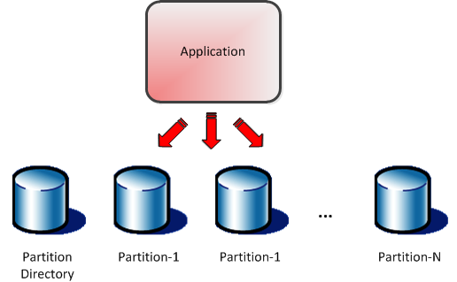
Databases – Sharding
Partition data across masters
Writes & Reads are distributed
Application needs modification
Needs choice of partitioning strategy for uniform data distribution
Issues
Joins cannot be performed across shards
Application modification can be expensive
Example
Evernote uses database sharding – localized failures, no need for joins
Each shard handles all data & traffic for about 100,000 users

Slide 14
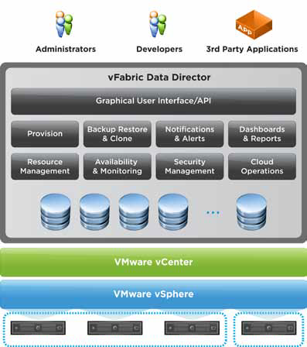
vFabric Data Director
Database-as-a-Service
vFabric Postgres
Database Cloning: In minutes even for large databases
Elastic Database Memory: Integrate database memory with vSphere
100% PostgreSQL compatible
RBAC
Database aware high availability

Slide 15
NoSQL Databases
MongoDB
Document oriented database
Index on any attribute
Support for sharding – horizontal scalability
Master-Slave replication & Replica sets
Example document:
{
"username" : "bob",
"address" : { "street" : "123 Main Street", "city" :
"Springfield", "state" : "NY" }
}
Migration using replicas across regions
Switch after syncing the slave without any downtime

Slide 16
Reserving Scalability
Reserved Instances
AWS has finite hardware capacity
Provisioning times can vary
Use few reserved instances to “book” capacity in advance (also take advantage of lower prices)
Can be done across availability zones to ensure DR
Larger EBS disks
Create larger EBS disks to ensure better performance
Netflix creates 1TB disks in this manner

Slide 17
There are some limits…
EC2 has limit of 20 instances
S3 has limit of 100 buckets
Simple Email Service (SES) has a daily sending quota
NOTE: All of these limits can be increased or waived by requesting AWS. Ensure to do this before you hit the limits in production.

Slide 18
Minimize Costs - 1
Use of Reserved Instances
Commitment for upto 1-3 years with some upfront payment
Actual usage cost is much lower
If used for more than 6 months in a year, can be 30-45% cheaper than on-demand instances
Reduced Redundancy Storage
Reduce costs by storing non-critical data at lesser redundancy and lesser availability/durability of 99.99%
Instance Sizes
Run some smaller instances as part of clusters

Slide 19
Minimize Costs - 2
Data Transfer beyond 10TB
Consolidate AWS accounts so that higher usage translates to saved costs. $0.15 upto 10TB and $0.11 beyond 10TB.
Identify extra capacity
Use monitoring to identify unused capacity & optimize
Spot Instances
Bid for unused capacity – choose your maximum price
Get more within your existing budget

Slide 20
IAM
Identity & Access Management
Create users and groups with permissions for each
Each user has unique security credentials so need to share credentials for usage
Important for auditing
Can be used to control access to all services

Slide 21
Best Security Practices - 1
Protect your data in transit with SSL or another form of encryption
Encrypt data that is stored on the cloud using opensource or commercial PGP based tools
Use VPC or VPN
Encrypt your disks on the cloud for extra layer of security using encryption filesystems
Windows Encrypting File System
TrueCrypt
dmcrypt
Protect cloud credentials

Slide 22
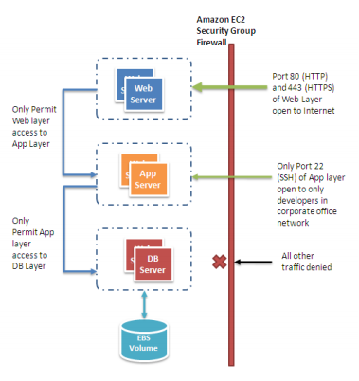
Best Security Practices - 2
TCP, UDP ports
ICMP types
Source addresses
You can also use OS firewalls if you desire
Never run anything as root
Ensure your OS is patched with security updates
Monitor open ports

Slide 23
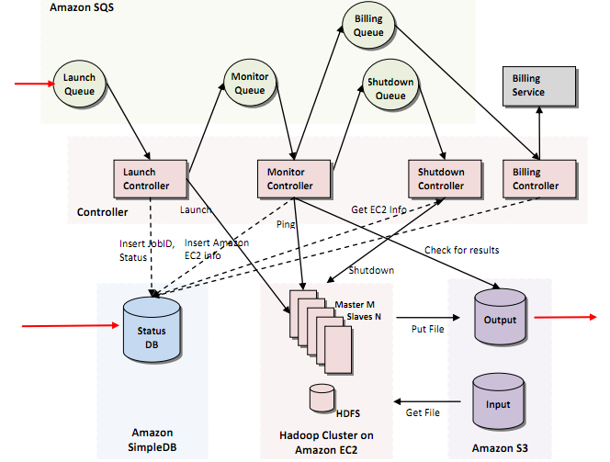
Greptheweb

Slide 24
Cloud Successes

Slide 25
Common Parameters for Success
Cost Savings?
Agility?
Stability?
Scaling up or down on-demand?
Cloud Platform support?
Security & Compliance?
Extensibility?

Slide 26
Examples
Processing Pipelines
Document processing pipelines – convert hundreds of thousands of documents from Microsoft Word to PDF, OCR millions of pages/images into raw searchable text
Image processing pipelines – create thumbnails or low resolution variants of an image, resize millions of images
Video transcoding pipelines – transcode AVI to MPEG movies
Indexing – create an index of web crawl data
Data mining – perform search over millions of records
Batch Processing Systems
Back-office applications (in financial, insurance or retail sectors)
Log analysis – analyze and generate daily/weekly reports
Nightly builds – perform nightly automated builds of source code repository every night in parallel
Automated Unit Testing and Deployment Testing

Slide 27
Examples
Websites
Websites that ―sleep‖ at night and auto-scale during the day
Cloud University example
Instant Websites – websites for conferences or events (Super Bowl, sports tournaments)
Promotion websites
Seasonal Websites‖- websites that only run during the tax season or the holiday season (Black Friday‖ or Christmas)

Slide 28
Zynga’s Cloud Strategy
Zynga uses the public cloud infrastructure (AWS) for new game releases
Manage unpredictable loads since games can go viral
Hybrid Cloud Approach
If game becomes popular and part of long term strategy – then they move the infrastructure in-house in their own private cloud (Cloud.com)
Use RightScale for hybrid cloud management
Use infrastructure in multiple geographies for low latencies
Leverage services in skewed manner – extreme agility & flexibility

Slide 29
Case Study
SES
AZ1
Auto Scaling Group - Apache
Auto Scaling Group - Django
App Server Managed Scaling
AZ2
Web Server 1
(Reserved)
App Server 1
(Reserved)
Work Server
Local DB
ELB
LB
Work Server
Work Server
scalableportal.com
Web Server n
App Server n
3rd Party API
App Server n
MySQL Master
No listing,
Hash based access,
Millions of files
MySQL Slaves
Amazon S3
EBS Snapshots

Slide 30
DR Product Scalability
Customer has product that needs to monitor and manage about 50k-500k servers around the world
Requirements for this DR product
100% Uptime
Scalability
We used Amazon S3 to act as the HeartBeat location
Servers log their HB in S3 objects
Our application queries S3 for updates (as light as a lookup)
Saved costs of setting up server farm
Costs about 5-10% of what it would cost to run a server farm for 1-minute heartbeats

Slide 31
ShopSocially Migration
Let’s look at their architecture diagram

Slide 32
Cloud Asset Automation
ss_provision_webserver_node: Spawn a Webserver Instance from specified AMI
ss_provision_redis_node: Spawn a Redis Instance from specified AMI
ss_provision_mongo_node: Spawn a MongoDB Instance from specified AMI
ss_provision_staticjs_node: Spawn a Static WebServer Instance from specified AMI
ss_provision_celery_node: Spawn a Celery Instance from specified AMI
ss_provision_analytics_node: Spawn an Analytics Instance from specified AMI
ss_provision_rabbitmq_node: Spawn a RabbitMQ Instance from specified AMI
ss_configure_node: Configure a provisioned node to become production-ready
ss_create_aws_ami: Create an AMI of the running instance
ss_backup_datastore: Create a snapshot for all the datastores.
ss_deploy_code: Update the webservers and celery workers with latest code.
ss_update_metric: Update metrics like Memory usage, disk usage periodically
ss_list_metrics: List the existing configured custom-metrics
ss_change_cron_sched: Setup the “ss_backup_datastore” as a cron job
ss_global_status: Check the global status of the infrastructure.

Slide 33
Blitz.io – Cloud Perf Testing
Simulate very heavy loads – useful for NDS?
Web-tier on Heroku – RoR, managing business workflows
CouchDB – running on EC2, multi-region for redundancy & latency
Use IAM for security & better multi-tenancy (access to environment variables)
Multi-region scaling
Generates 50,000 concurrent HTTP requests on single small EC2 instance
Multi-tenant load testing product

Slide 34
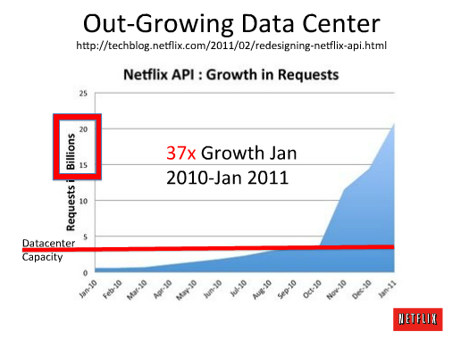
Netflix’s Cloud Architecture - 1
Using cloud for better business agility & unpredictable growth
Product launch spikes
Almost 100% Cloud !

Slide 35
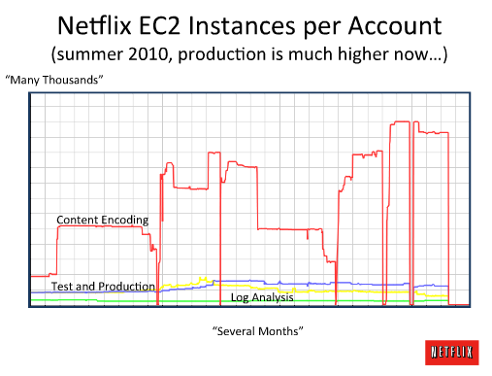
Netflix’s Cloud Architecture - 2
What they mostly use the cloud for…

Slide 36
Assessing Java EE Applications
Java EE APIs used
Java EE server services outside specification (eg. CORBA)
Third party libraries and services
Code quality – coupling, layering, etc.
Useful / Good
Well architected, layered application
Use of servlet-spec security or spring security
Can continue using JMS
You can drop in standard WARs like JavaMail, JMS, JAF, Web Services, JAX-WS, JAXB, etc.

Slide 37
Assessing Java EE Applications
Issues
Strong adoption of EJBs and no exposure to lightweight technologies like Spring
Session EJBs, Stateful behavior
Integration with proprietary application server APIs
Need distributed transactions

Slide 38
Code Migration Best Practices - 1
Layered, interface-driven, decoupled architecture
Dependency injection
Easier manageability, testing, agility
Does it provide long term benefits?
Migrate in parts
Migrate session EJBs to POJO implementations of services one-by-one
Migrate by vertical or slice
Service layer
Service layer written in EJB may need migration

Slide 39
Code Migration Best Practices - 2
Data Access Layer (DAO)
Entity EJBs will need to be migrated
Web & Presentation Layer
Little work needed here: service related changes may be needed
Managing Transactions
Local Resources: JDBC Connection, JPA’s EntityManager, Hibernate’s Session
JTA: Can be used with third party library
Abstraction is ideal here
Spring Framework transaction management
Example: Abstract JDBC datasource inside DataSourceTransactionManager

Slide 40
Code Migration Best Practices - 3
Container Managed Security in EJBs
Replace with Spring Security
Custom XML, Pluggable
HTTP requests authorization
LDAP, OpenID, Kerberos integrations
Or custom application code
Messaging
EJB message driven beans to RabbitMQ or other messaging services

